Slide 1
NCR No: 11961
QER: JULIMAR DEVELOPMENT PHASE 3 SF301229C002.05+06+07 - Zeta wires unlocked

Slide 2
Pipe Section Details
Item | Traceability / Identification
Project Number | 301229C002
Project Name | JULIMAR DEVELOPMENT PHASE 3
Pipe Section | SF301229C002.05+06+07
Structure number | ST203.72124
Affected Layer | Zeta Pressure Vault
Length Affected | 44.8m
Drawing Number / MP Code / STA | ZETA 6.2 FI09 (MP205)

Slide 3
Overview of Anomaly
Problem Description:
During the zeta spiraling of JULIMAR DEVELOPMENT PHASE 3 SF301229C002.05+06+07 (ST203.72124), zeta wire unlocked was detected at length 44.8m on the pipe.
Root Cause:
  The root cause due to wires entangled in bobbin #002 during running causing wire damage and wire unlock at laying point.
Immediate Action Taken:
  Reparation by un-spiral has been performed to re-position the wires to be in a good spiral. This reparation was accepted as it is and the dimension after the repair are within the criteria.

Slide 4
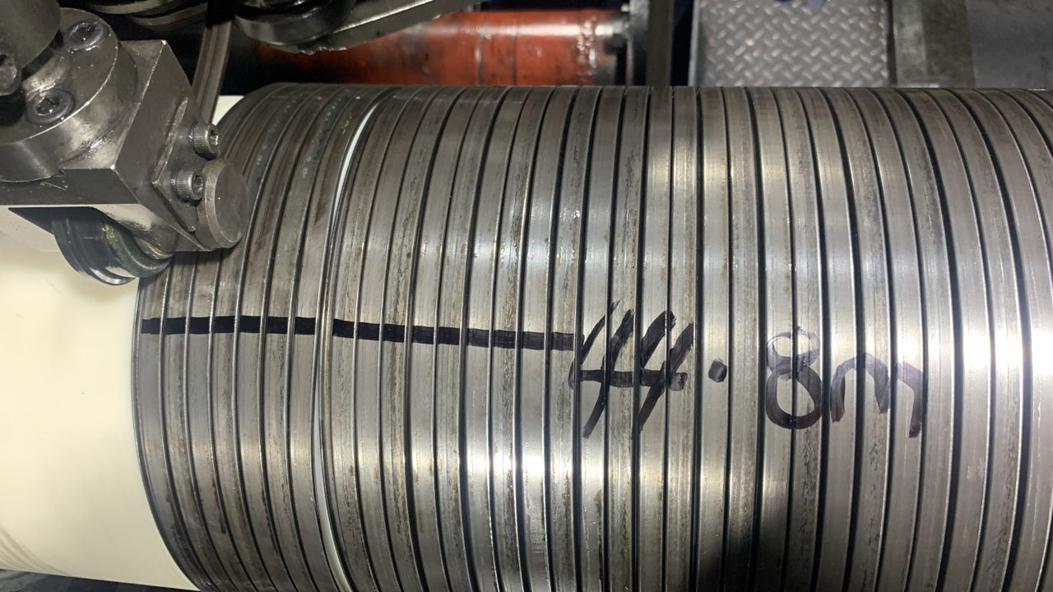
Defect Photos
Figure 1 : Zeta wire unlocked was detected at length 44.8m on the pipe.

Slide 5
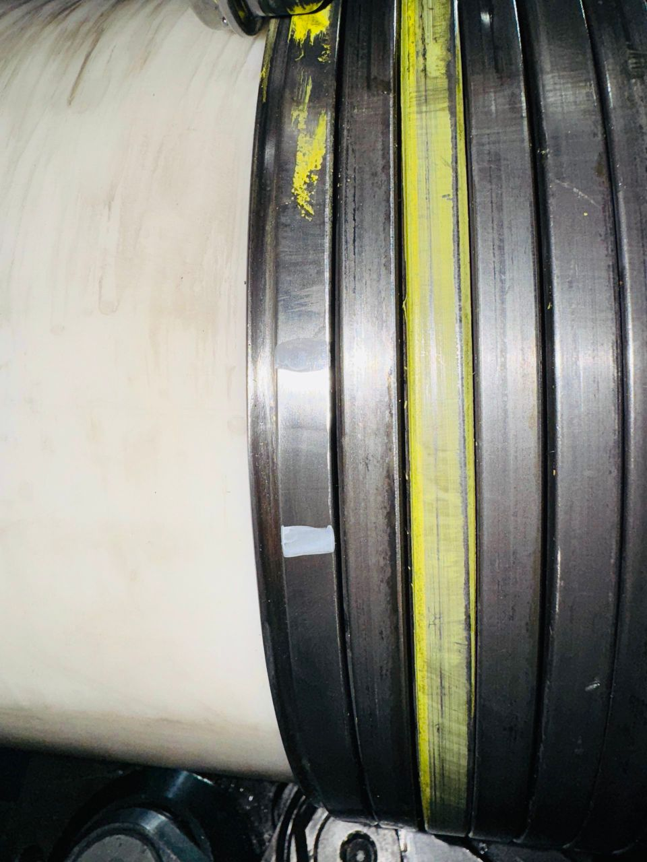
Repair Photos
Adjustment shaft
Wire dislocate through the gap
Figure 2 : Reparation by un-spiral has been performed to re-position the wires to be in a good spiral.

